Slide 1
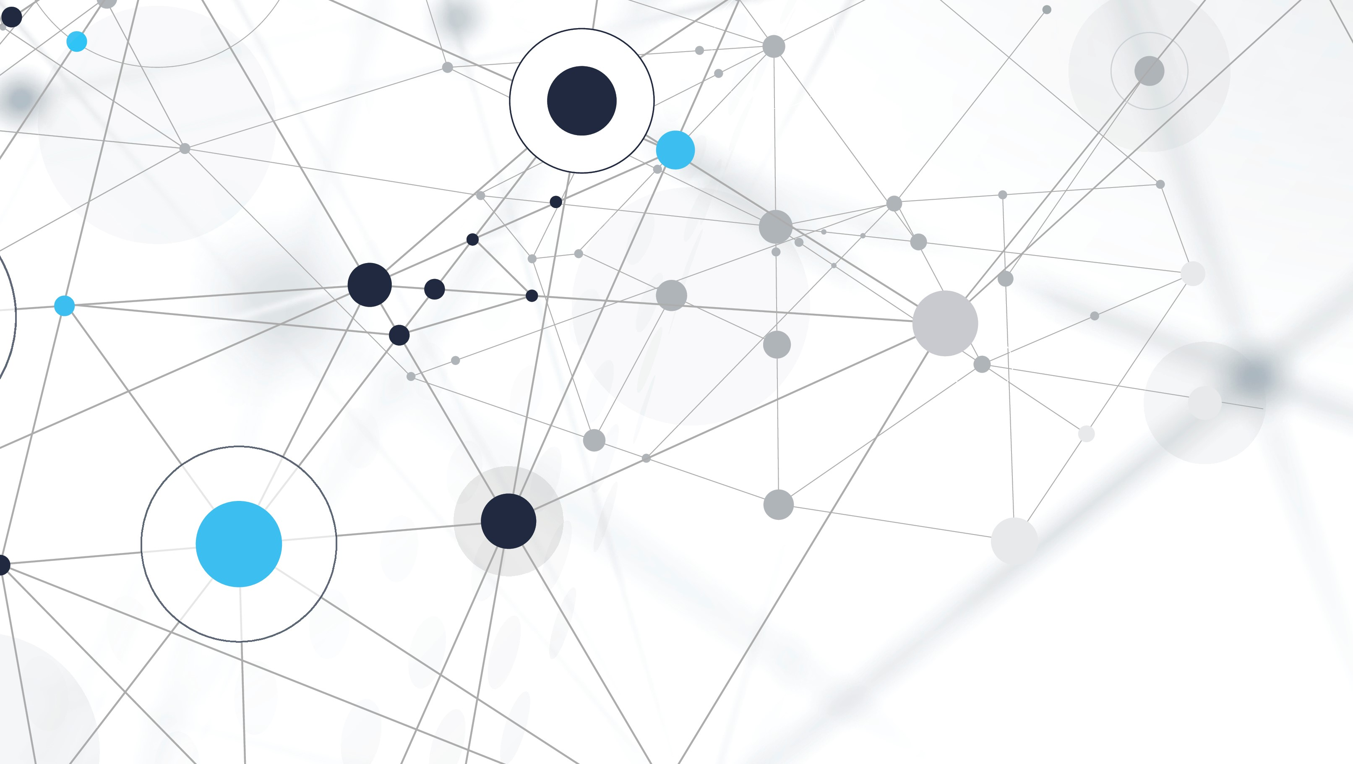
Image classification with nn
Hussein jouni

Slide 2
objective
Build a model to classify images into their appropriate categories (forest, lake, desert, cloud).
Build a model to segment images.

Slide 3
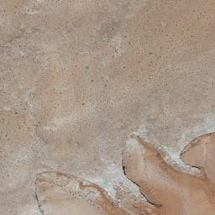
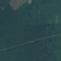


Image classification
Desert
Forest
Lake
Cloud

Slide 4
Phases
Build the network
Test the model
Preprocess data phase
NN phase
Process the data
Train the network

Slide 5
Process the data
Convert the images to numpy array :
resize all the images to the same Hight and width .
normalize the data .
Using CV2 library we can read an image , resize it and converted to numpy array .
def read_image(path):
x=cv2.imread(path)
x=cv2.resize(x,dsize=(128,128))
x=x/255.0
return x
for i in range(len(paths)):
train_data_x[i]=read_image(train_x[i])

Slide 6
Labeling the data by One Hot Encoded :
Labeling the images into 0 or 1 by indexing the classes
Give 1 to the class and 0 to the rest of the classes
Randomize the data and split it into train and test dataset
1 | 0 | 0 | 0
0 | 1 | 0 | 0
0 | 0 | 1 | 0
0 | 0 | 0 | 1
FOREST
LAKE
DESERT
CLOUD

Slide 7
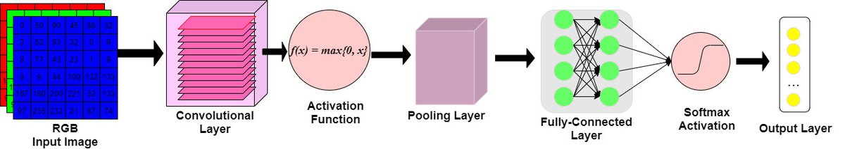
Build the network
CNN designed to recognize spatial relationships in data, making it effective for image classification .
CNN composed of three main layer:
Convolutional layer
Pooling layer
Fully-connected layer

Slide 8
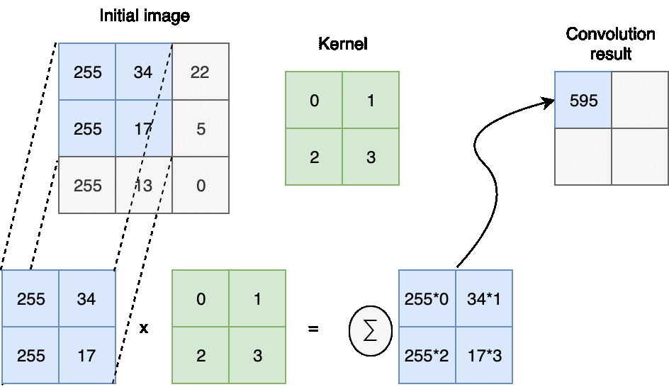
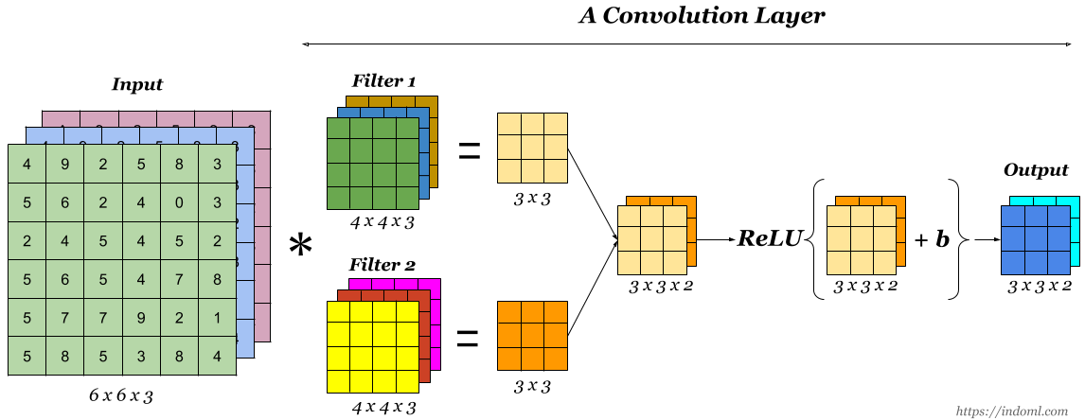
Convolutional layer
Convolutional layer is the building blocks of CNNs. This layers is made of many filters, which are defined by their width, height, and depth.
It apply convolutional operation to capture spatial features , using this filters/kernels
Filters slide across the image from left-to-right, taking as input only a subarea of the image, in every slide dot products are calculated between the filters and the subarea of the image .

Slide 9
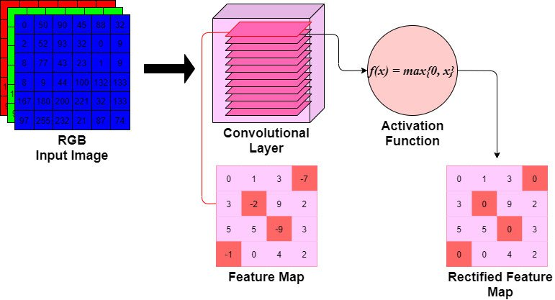
Activation function in Convolutional layer
The output of the Conv. layer is fed to an activation function, commonly a (ReLu).
This activation function add non-linearity to the network
A ReLu function will apply a 𝑚𝑎𝑥(0,𝑥) function, thresholding at 0.

Slide 10
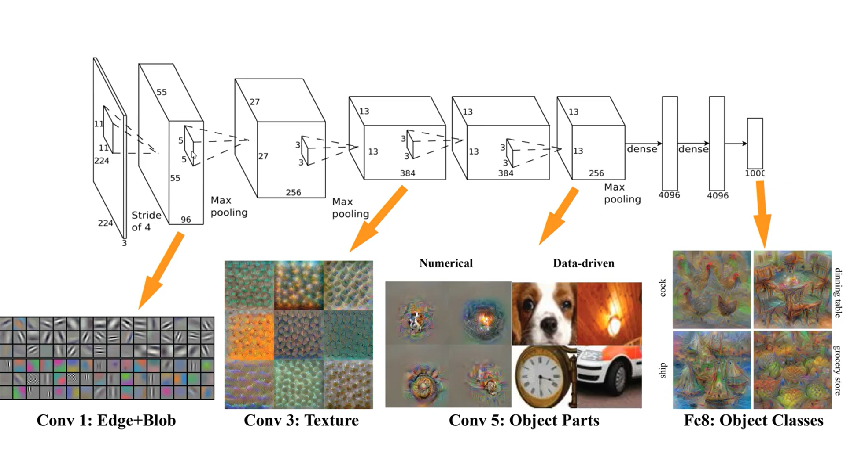

Slide 11
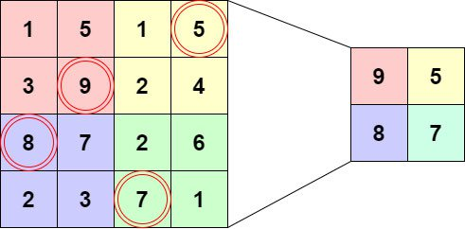
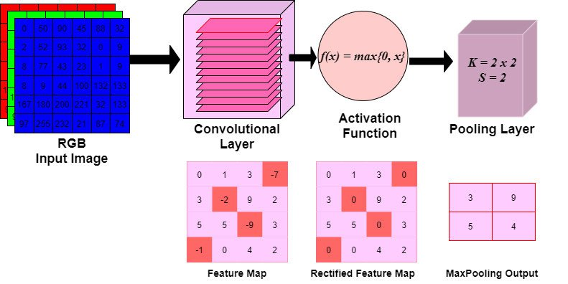
Polling layer
The output of the activation function is fed to the polling layer
The purpose of this layer is to reduce the width and height of the output through max-pooling or average-pooling (here max-pooling)

Slide 12
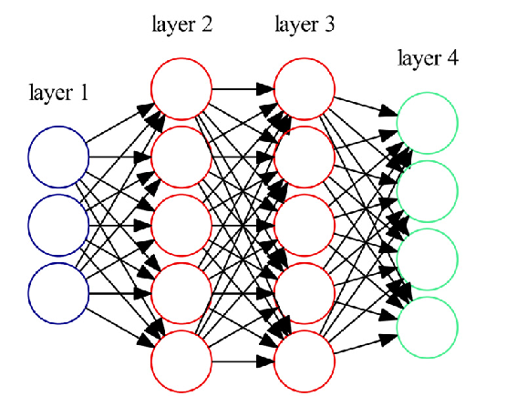
Fully-connected layer
The output features are passed to a Fully-Connected Layer .
This layer is like a typical MLP network.
Use Softmax activation function in the output layer ensures that the sum of values in the output layer equal to 1

Slide 13
Build the network in Tenser flow
cnn=models.Sequential([
layers.Conv2D(filters=32,kernel_size=(3,3),activation='relu',input_shape=(128,128,3)),
layers.MaxPooling2D(),
layers.Conv2D(filters=64,kernel_size=(3,3),activation='relu'),
layers.MaxPooling2D(),
layers.Flatten(),
layers.Dense(64,activation='relu'),
layers.Dense(4,activation='softmax')]
)

Slide 14
Train the network
Training a neural network typically consists of two phases:
A forward phase, where the input is passed completely through the network.
A backward phase, where gradients are backpropagated and weights ,bias (in the fully connect layer) and filters values (in the convolution layer) are updated.
any backward phase must be preceded by a corresponding forward phase.
During the backward phase, each layer will receive a gradient and also return a gradient. It will receive the gradient of loss with respect to its outputs (∂𝐿/∂out​) and return the gradient of loss with respect to its inputs (∂𝐿/∂in​) this gradient loss will pass to the previous layer.

Slide 15
Train the network in Tenser flow
cnn.compile(optimizer='adam',loss='categorical_crossentropy',metrics=['accuracy’])
epochs=30
cnn.fit(x_train,y_train,
epochs=epochs,
)

Slide 16
test the network
cnn.evaluate(x_valid,y_valid)
y_predict=cnn.predict(x_valid)

Slide 17
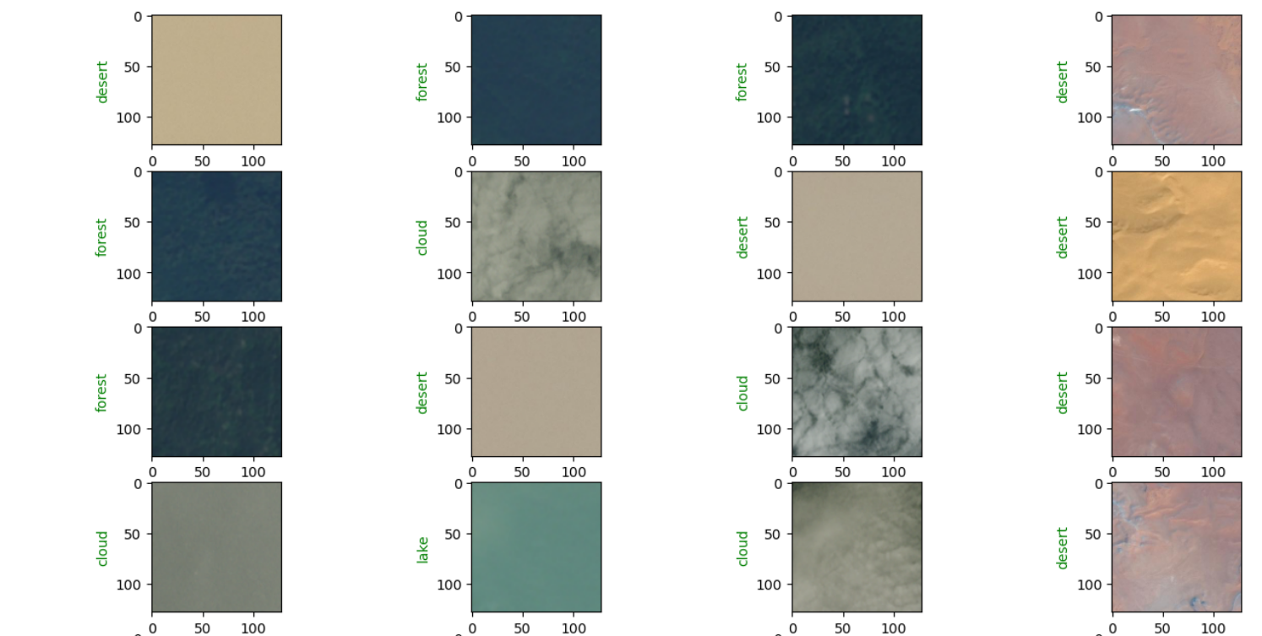
testing

Slide 18
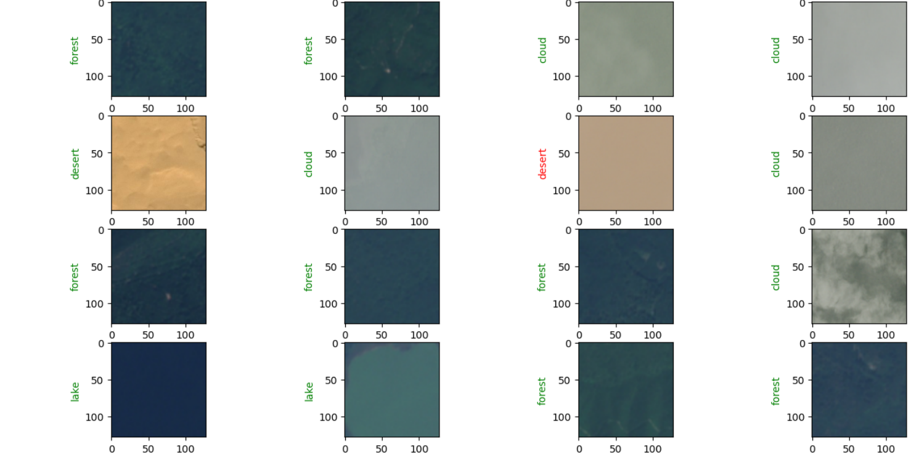

Slide 19
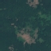
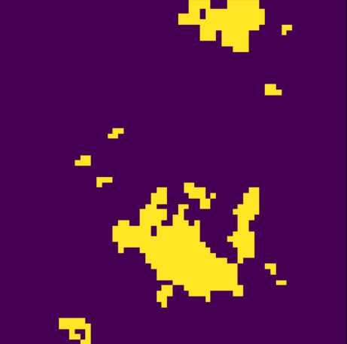
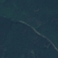
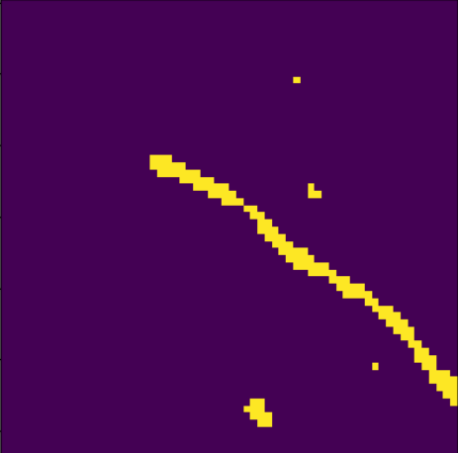
Image segmentation

Slide 20
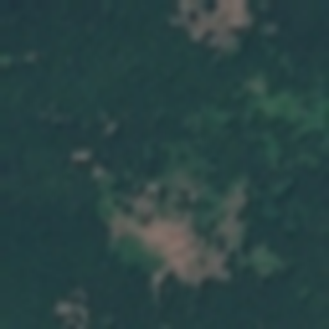
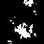
Process the data
Same as before but what change is the labeling proses .
Her the label is a segmented image with the same height and width of the input image.
Ta label the data we should label every pixel in every image .
To label the train data I used k-men algorithm with 2 cluster (k=2) and the applying threshold to get black and white image (gray scale , dim=1)
The input train image
The labeled train image

Slide 21
Build the network
To solve this problem the output of the NN should be an image .
To do that we will use a U-NET .
U-NET is a deep learning architecture for image segmentation it consist of encoder network which down samples the input image to features and a decoder network witch up samples the encoded features to the original image size .

Slide 22
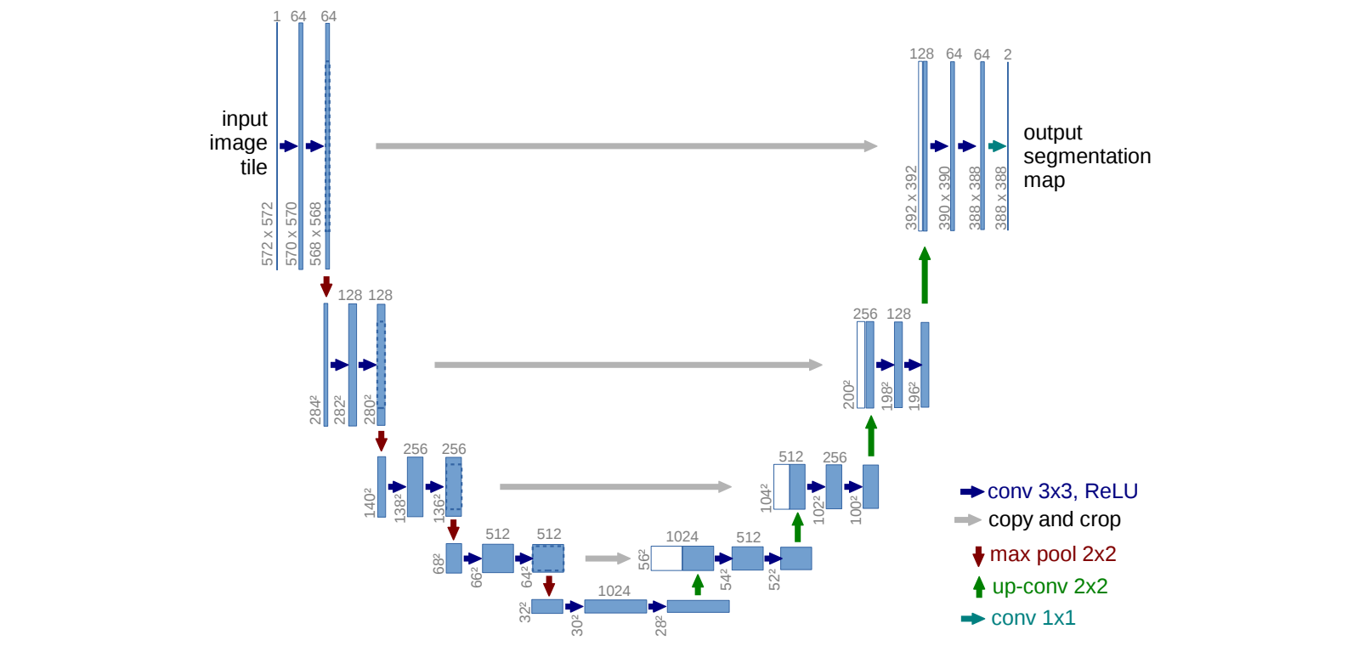

Slide 23
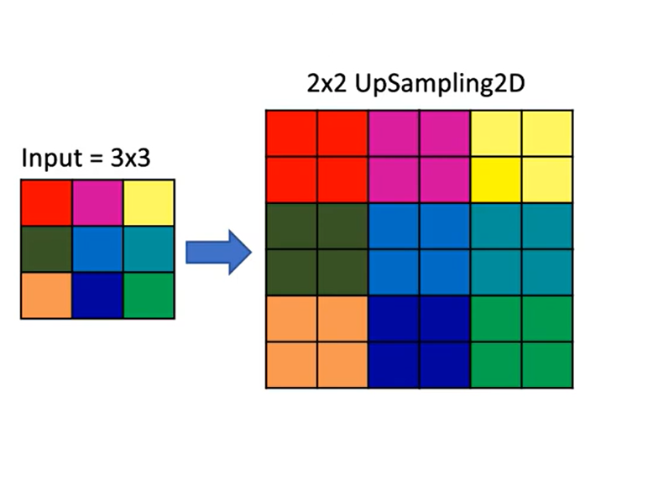
Up sampling
In U-Net, up-sampling is a crucial part of the decoder path. It involves increasing the spatial resolution

Slide 24
concatenation
concatenation refers to the process of combining feature maps To improve the precision of the segmentation and retain spatial information.
Concatenation Operation:
At each level of the upsampling path, the feature maps from the corresponding downsampling step are concatenated with the upsampled feature maps. For instance, if you have feature maps of size ( 64 x64 x128) from the downsampling path and( 64x64x64 ) from the upsampling path, after concatenation, you would get feature maps of size ( 64 x64 x192 )

Slide 25
Encoder block
Encoder block compose of 2 convolution layer (with activation function ‘RELU’ ) with a number of filter, and a max-polling layer
def conv_block(inputs, num_filters):
x=Conv2D(num_filters, 3, padding="same")(inputs)
x=Activation("relu")(x)
x=Conv2D(num_filters, 3, padding="same")(x)
x=Activation("relu")(x)
return x
def encoder_block(inputs, num_filters):
x=conv_block(inputs, num_filters)
p=MaxPool2D((2, 2))(x)
return x,p

Slide 26
Decoder block
decoder block compose of an up-scaling layer , concatenation layer and 2 convolution layers
def conv_block(inputs, num_filters):
x=Conv2D(num_filters, 3, padding="same")(inputs)
x=Activation("relu")(x)
x=Conv2D(num_filters, 3, padding="same")(x)
x=Activation("relu")(x)
return x
def decoder_block(inputs, skip, num_filters):
x=UpSampling2D((2, 2))(inputs)
x=Concatenate()([x,skip])
x=conv_block(x,num_filters)
return x

Slide 27
Build the network
def build_unet(input_shape):
inputs=Input(input_shape)
s1,p1=encoder_block(inputs,32)
s2,p2=encoder_block(p1,64)
s3,p3=encoder_block(p2,128)
b1=conv_block(p3,256)
d1=decoder_block(b1,s3,128)
d2=decoder_block(d1,s2,64)
d3=decoder_block(d2,s1,32)
outputs=Conv2D(1,1,padding="same",activation="sigmoid")(d3)
model=Model(inputs,outputs,name="UNET")
return model

Slide 28
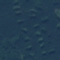
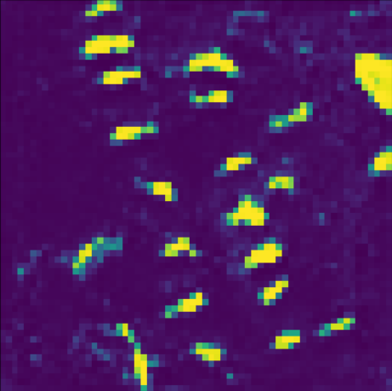
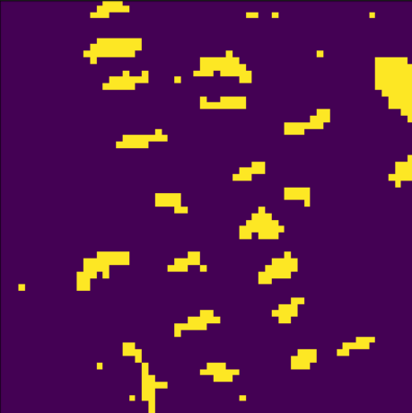
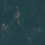
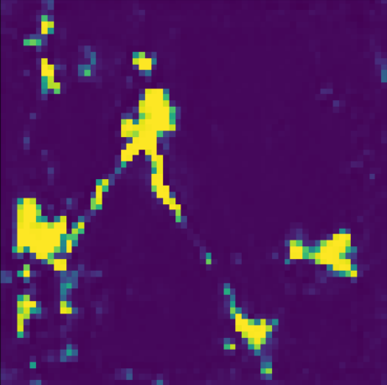
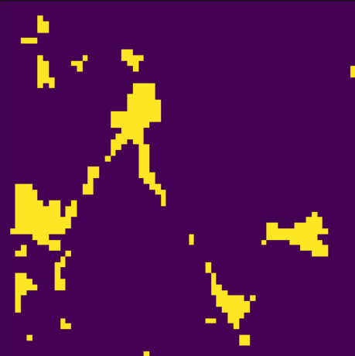
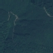
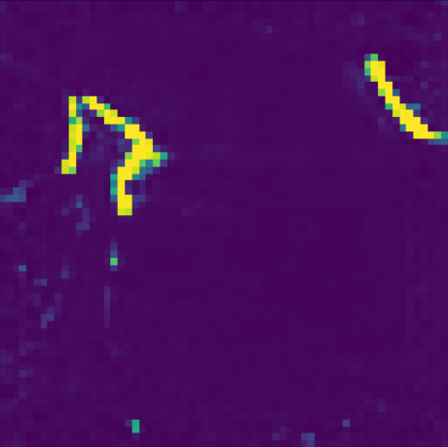
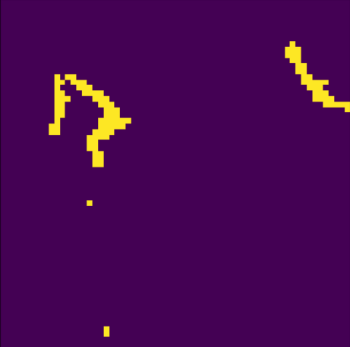
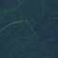
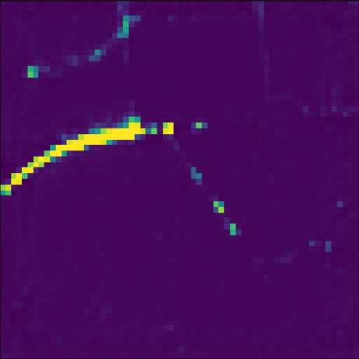
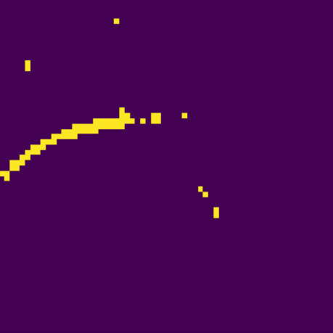
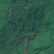
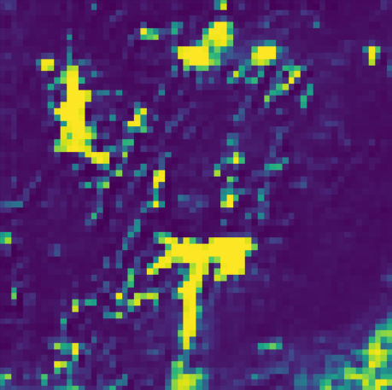
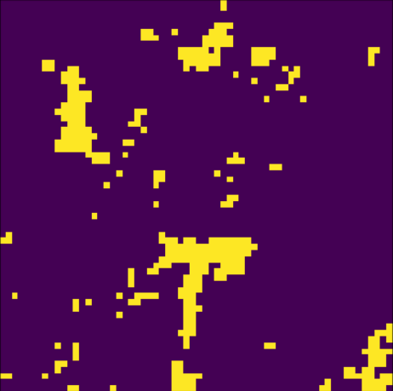
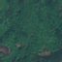
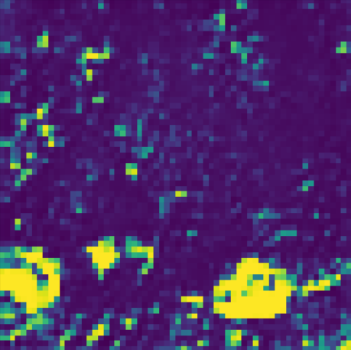
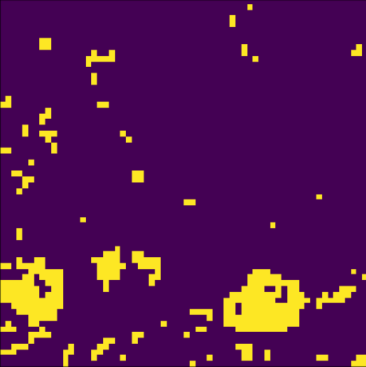
testing

Slide 29
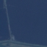
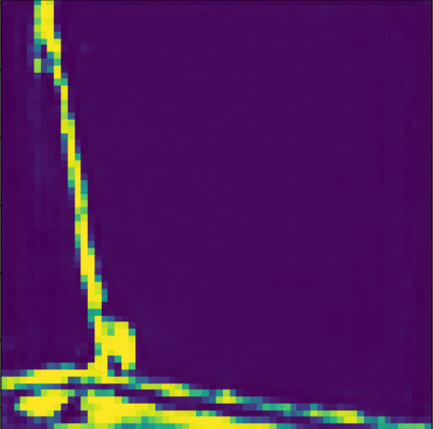
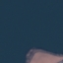
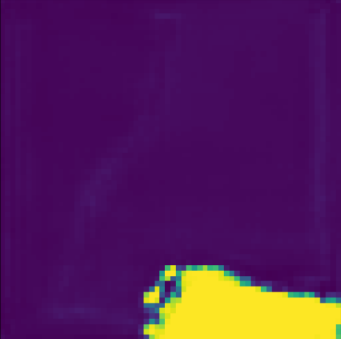
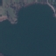
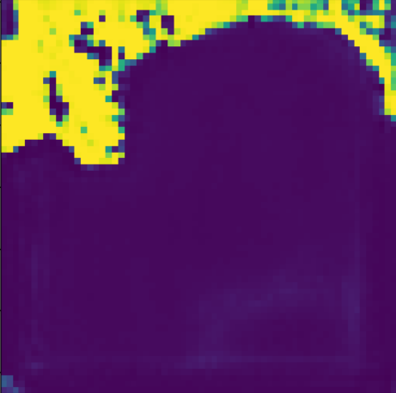
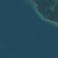
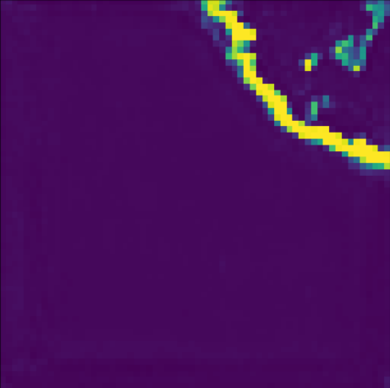
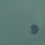
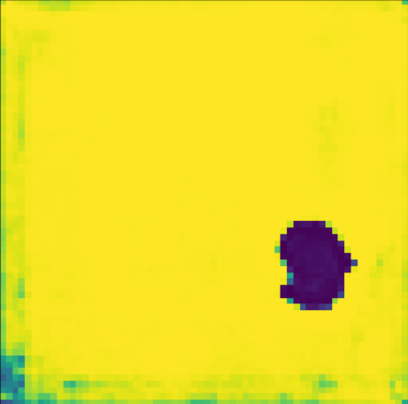
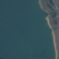

Testing on different dataset

